Slide 1




NEXT GEN EMPLOYABILITY PROGRAM
Creating a future-ready workforce
Team Members
Arunachala College Of Engineering For Women
Student Name :Yesu Thanga Joy .Y
Student ID : au960221243051

Slide 2

CAPSTONE PROJECT SHOWCASE
Project Title
Car Rentals Application with Django Framework
Abstract | Problem Statement | Project Overview | Proposed Solution | Technology Used | Modelling & Results | Conclusion

Slide 3
Abstract
Car rental systems play a vital role in modern transportation services, providing individuals and businesses with convenient access to vehicles for short-term use.
This paper explores the functionalities, challenges, and advancements in car rental systems, focusing on key components such as reservation management, vehicle tracking, customer interaction, and payment processing.
It examines the technological innovations driving the evolution of car rental systems, including mobile applications, GPS tracking, and automated processes
Source :

Slide 4
Problem Statement
Reservation Management: Difficulty in managing and optimizing vehicle availability, especially during peak demand periods, leading to overbooking or underutilization of the rental fleet.
Vehicle Tracking and Security: Inadequate systems for monitoring vehicle locations, ensuring security, and preventing theft or unauthorized use of rental vehicles.
Customer Interaction: Limited options for seamless customer interaction, such as booking, payment processing, and support services, leading to friction in the rental process and dissatisfaction among users.
Maintenance Management: Lack of efficient processes for scheduling, tracking, and managing vehicle maintenance tasks, resulting in increased downtime, maintenance costs, and potential safety risks.
Source :

Slide 5
Project Overview
The project aims to develop a comprehensive car rental system that facilitates the efficient management of vehicle rentals, enhances user experience, and ensures the reliability and security of rental operations.
Features:
User Registration and Authentication:
Allow users to register and create accounts securely.
Implement authentication mechanisms to verify user identities and protect account information.
Vehicle Inventory Management:
Maintain a database of available vehicles, including details such as make, model, year, and availability status.
Enable users to search and browse vehicles based on their preferences and requirements.
Source :

Slide 6
Proposed Solution
Enhanced Vehicle Tracking and Security Features:
Integrate advanced GPS tracking technology with geofencing capabilities to monitor vehicle locations in real-time and establish virtual boundaries for rental areas.
Implement remote vehicle immobilization and anti-theft measures to enhance security and prevent unauthorized use or theft of rental vehicles.
Automated Maintenance Management System:
Deploy a centralized maintenance management system that automates scheduling, tracking, and monitoring of vehicle maintenance tasks.
Utilize predictive maintenance algorithms and IoT sensors to proactively identify potential issues and schedule preventive maintenance to minimize downtime and reduce repair costs.
Source :

Slide 7
Advanced Reservation Management System:
Implement an intelligent reservation management system that optimizes vehicle allocation, taking into account factors such as vehicle availability, customer preferences, and peak demand periods.
Utilize algorithms and predictive analytics to forecast demand and dynamically adjust rental prices and availability to maximize revenue and fleet utilization.
Streamlined Customer Interaction and Booking Process:
Develop intuitive and user-friendly interfaces for browsing available vehicles, making reservations, and managing bookings.
Offer seamless integration with mobile applications and responsive web design to facilitate booking and access to rental services on multiple devices.
Source :

Slide 8
Technological Integration and Innovation:
Explore emerging technologies such as blockchain for transparent and secure transaction processing, artificial intelligence for personalized customer experiences, and machine learning for predictive analytics and demand forecasting.
Leverage IoT devices and telematics solutions to gather real-time data on vehicle performance, usage patterns, and customer behavior, enabling data-driven decision-making and continuous improvement of rental services.
Robust Reporting and Analytics Tools:
Develop customizable reporting and analytics tools that offer insights into key performance indicators (KPIs) such as revenue, utilization rates, customer satisfaction, and fleet efficiency.
Empower rental operators with actionable data and visualization tools to identify trends, spot opportunities for improvement, and make informed business decisions to drive growth and profitability.
Source :

Slide 9


Technology Used
Front-end
Back-end
Source :

Slide 10
Modelling & Results
User Behavior Modeling: Understand user patterns like booking frequency, preferred vehicle types, booking duration, and peak booking times. You can use historical data or surveys to gather this information.
Fleet Management Modeling: Predict demand for different types of vehicles in various locations. This involves analyzing historical booking data, seasonal trends, and local events that might affect demand.
Pricing Strategy Modeling: Develop pricing models that consider factors like demand, vehicle availability, time until rental, and competitor pricing. Dynamic pricing algorithms can adjust prices in real-time based on demand and supply.
Operational Logistics Modeling: Optimize the allocation of vehicles to different locations based on predicted demand. This involves routing vehicles for maintenance, refueling, and redistribution to meet demand efficiently.
Source :

Slide 11
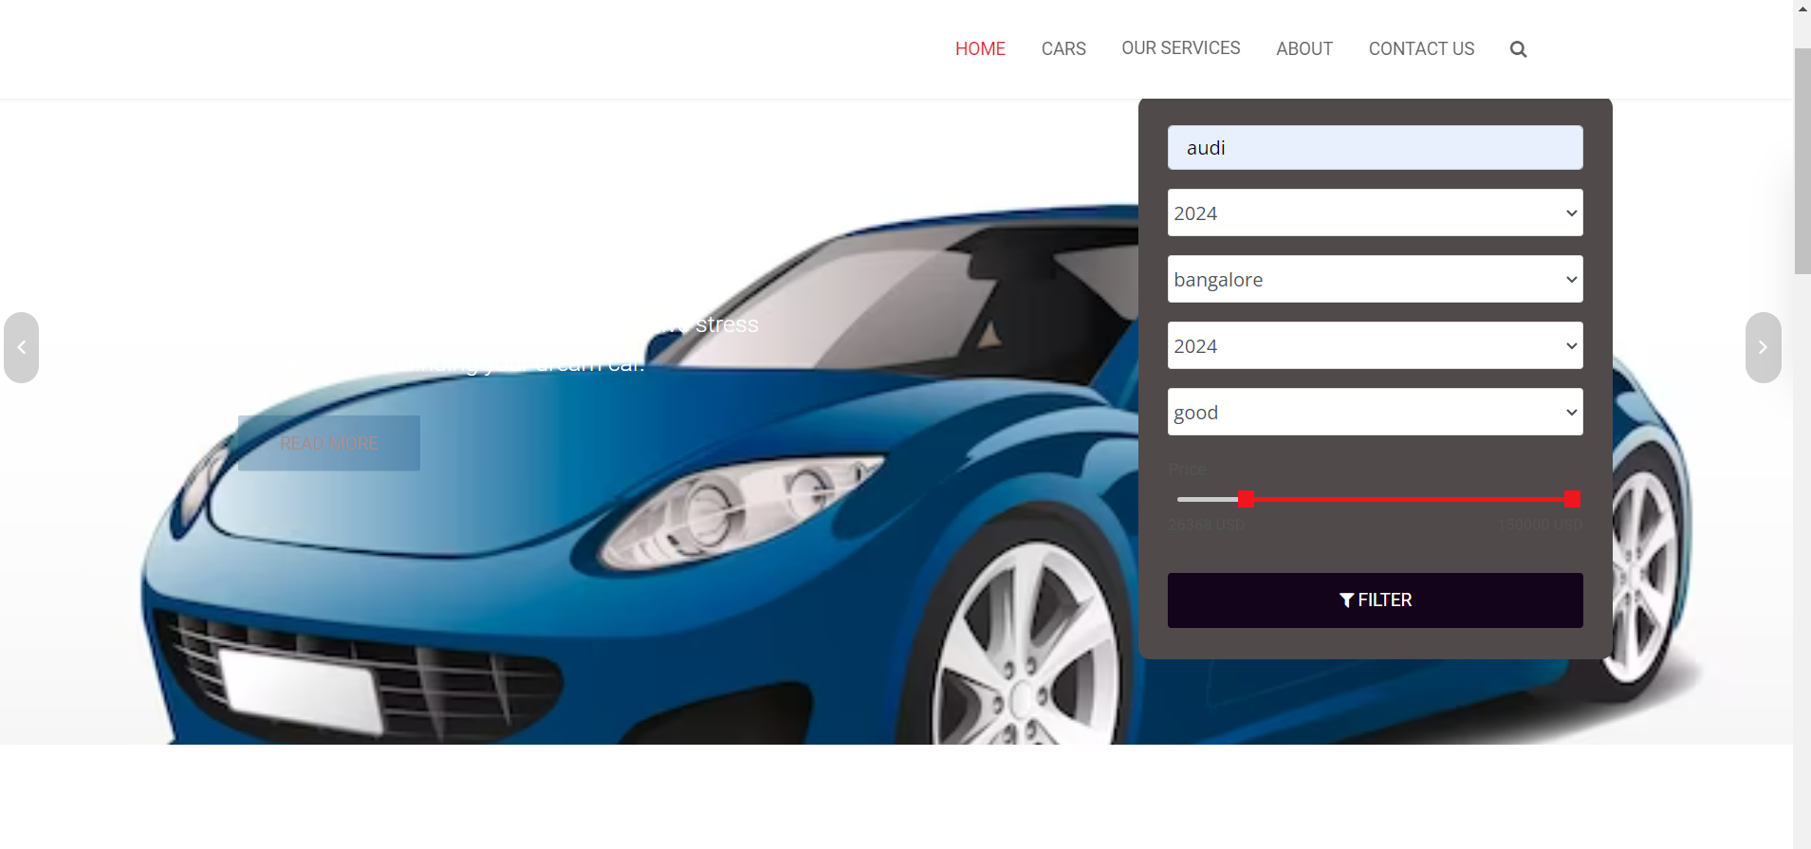
Homepage

Slide 12
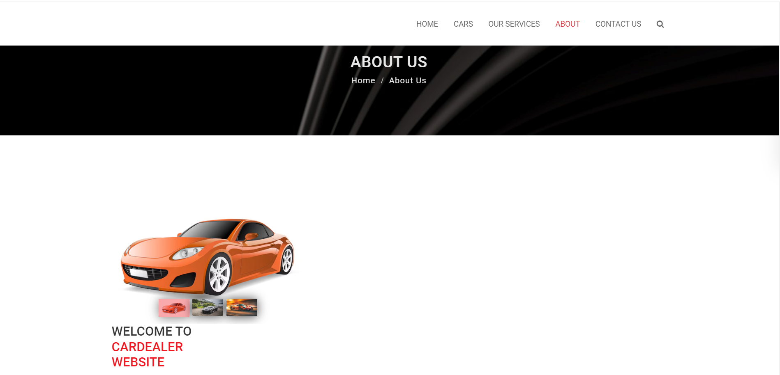
About-Us-Page

Slide 13
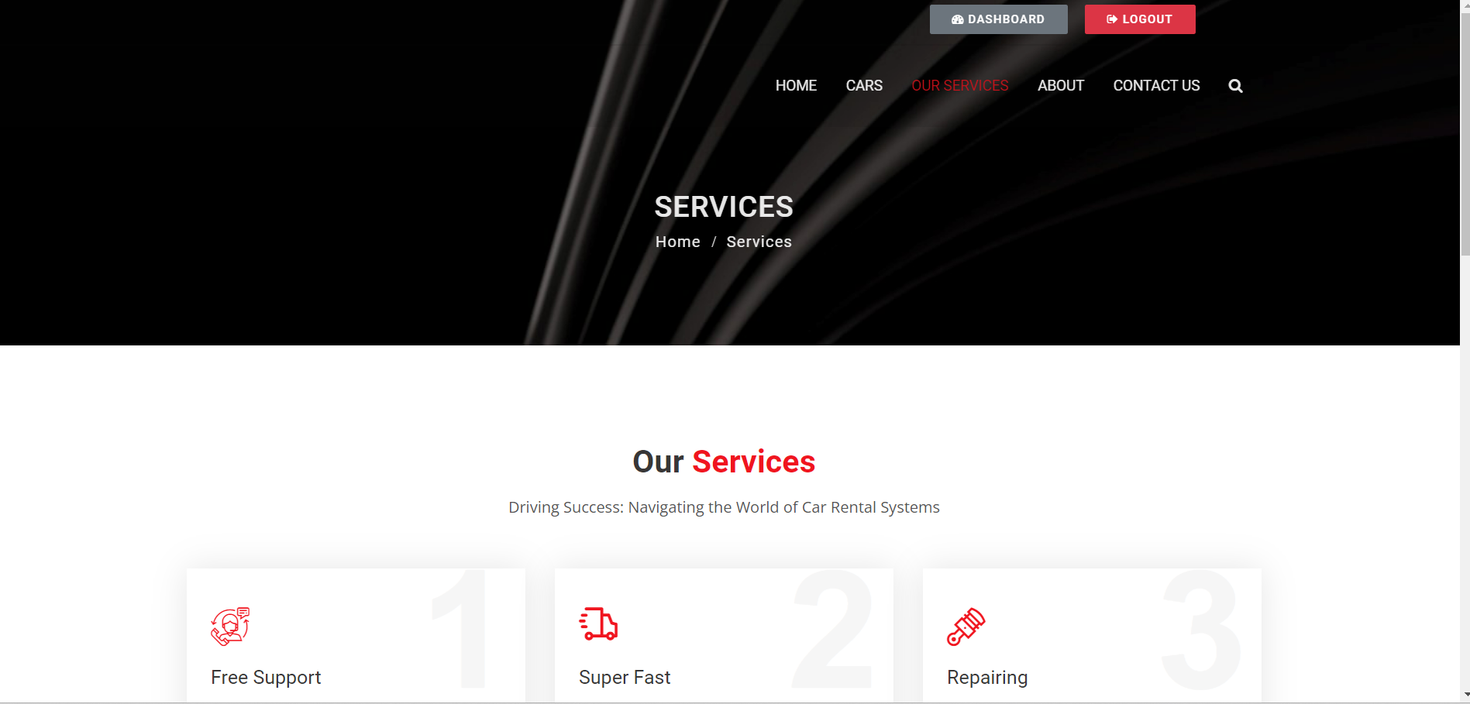
Service-Page

Slide 14
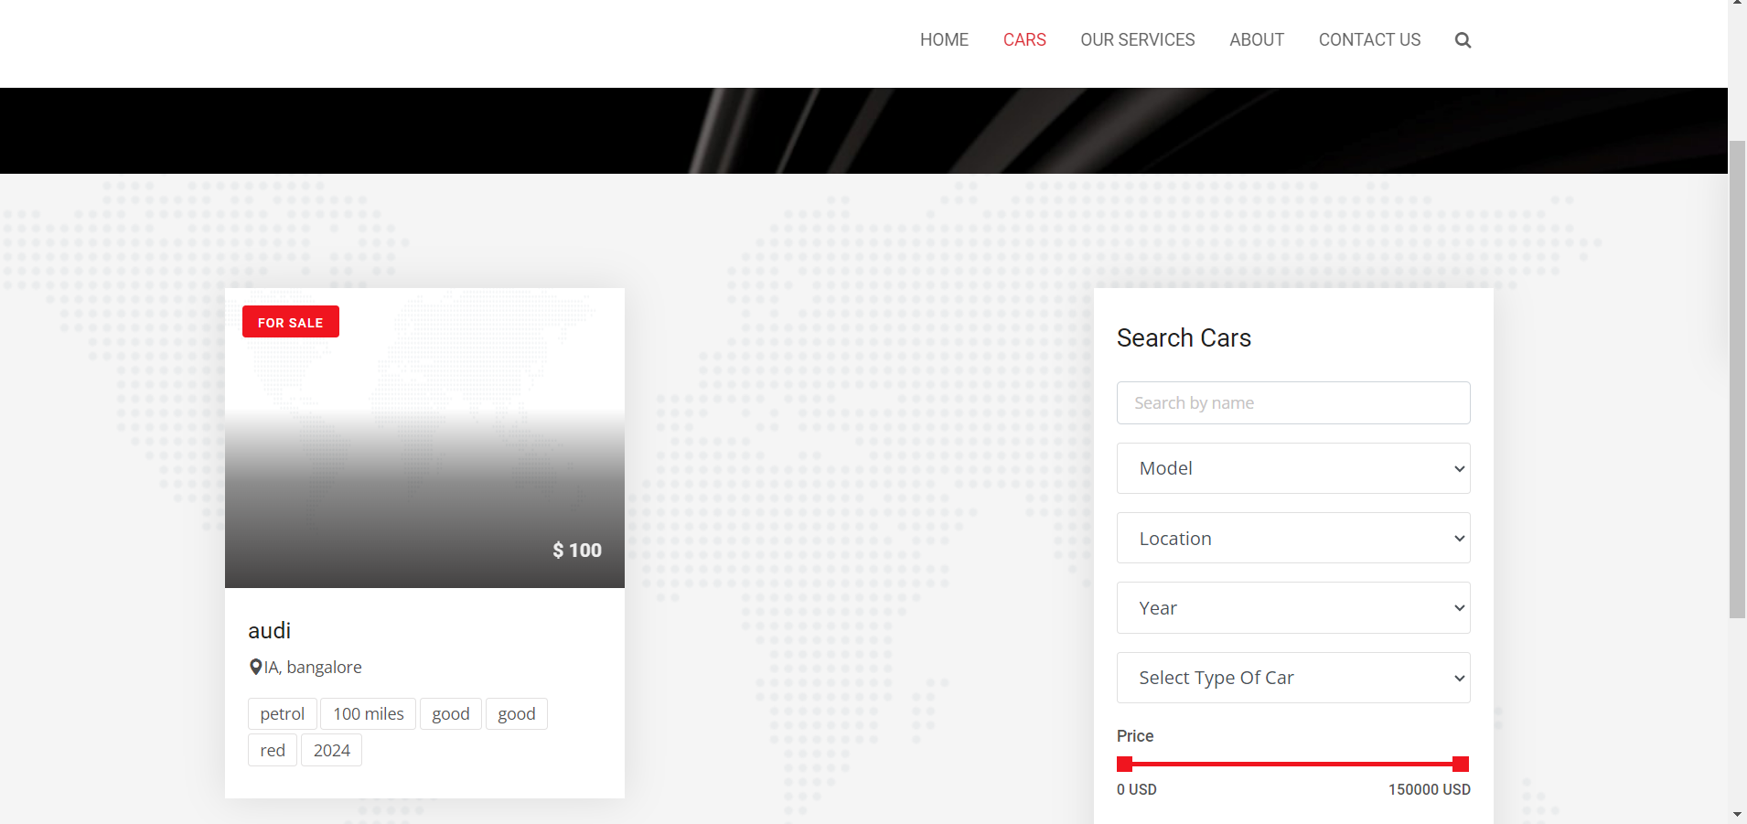
Departments-Page

Slide 15
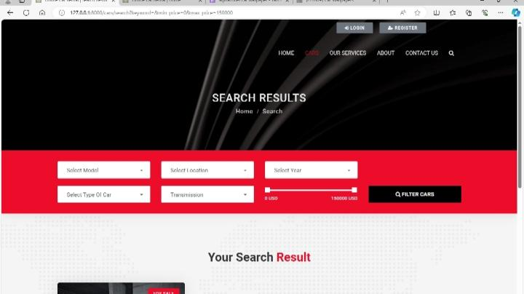
Blog-Page

Slide 16
Future Enhancements:
Integration of Autonomous Vehicles: As autonomous vehicle technology matures, car rental systems may incorporate self-driving cars into their fleets. This could lead to increased convenience for customers and lower operational costs for rental companies.
Electric and Sustainable Vehicles: With increasing concerns about climate change and environmental sustainability, there will be a growing demand for electric and other eco-friendly vehicles in rental fleets. Car rental systems can invest in expanding their electric vehicle offerings and implementing infrastructure for charging stations.
Augmented Reality (AR) for Vehicle Inspection: AR technology can streamline the vehicle inspection process by allowing customers to perform virtual inspections using their smartphones or AR glasses. This reduces the need for manual inspections and improves the accuracy of damage assessments.

Slide 17
Conclusion
In conclusion, car rental systems play a crucial role in providing convenient transportation solutions to customers worldwide. As technology continues to advance and consumer preferences evolve, the future of car rental systems holds exciting possibilities for innovation and improvement.
By embracing advancements such as autonomous vehicles, enhanced mobile experiences, blockchain technology, predictive maintenance, electric and sustainable vehicles, subscription-based models, augmented reality for vehicle inspection, and personalized services, rental companies can stay ahead of the curve and meet the changing needs of their customers.
These enhancements not only offer greater convenience and efficiency but also contribute to environmental sustainability, safety, and transparency within the industry. By continuously adapting and innovating, car rental systems can remain competitive and deliver exceptional value to customers in the years to come.
Source :

Slide 18
Thank You!
Notes:
Thank You !!

